Slide 1

LESSON 1
ABSTRACTION, SORTING & SEARCHING ALGORITHMS
IC217
DATA
STRUCTURES

Slide 2

Problem Solving Process
01
02
LESSON
TOPICS
03
04

Slide 3

01
02
ABSTRACTION
LESSON
TOPICS
03
04

Slide 4

01
02
LESSON
TOPICS
SORTING
ALGORITHMS
03
04
Bubble Sort
Insertion Sort
Selection Sort

Slide 5

01
02
Linear Search
Binary Search
LESSON
TOPICS
03
04
Searching
Algorithms

Slide 6
Linear Search
is used on a collections of items. It relies on the technique of traversing a list from start to end by exploring properties of all the elements that are found on the way.
Searching algorithm

Slide 7
In this type of search, a sequential search is made over all items one by one.
Every item is checked and if a match is found then that particular item is returned, otherwise the search continues till the end of the data collection.
Linear Search

Slide 8
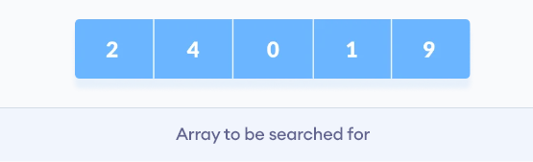
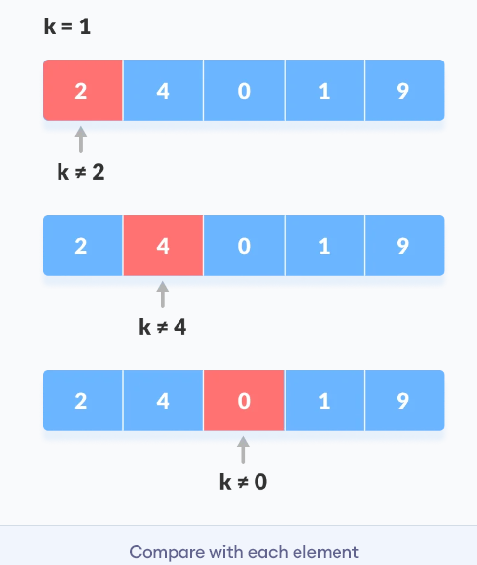
Linear Search
Start from the first element, compare k with each element x.

Slide 9
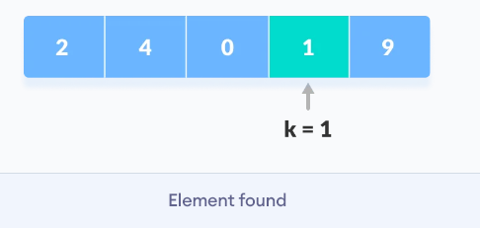
Linear Search
If x == k, return the index.
Else, return not found.

Slide 10
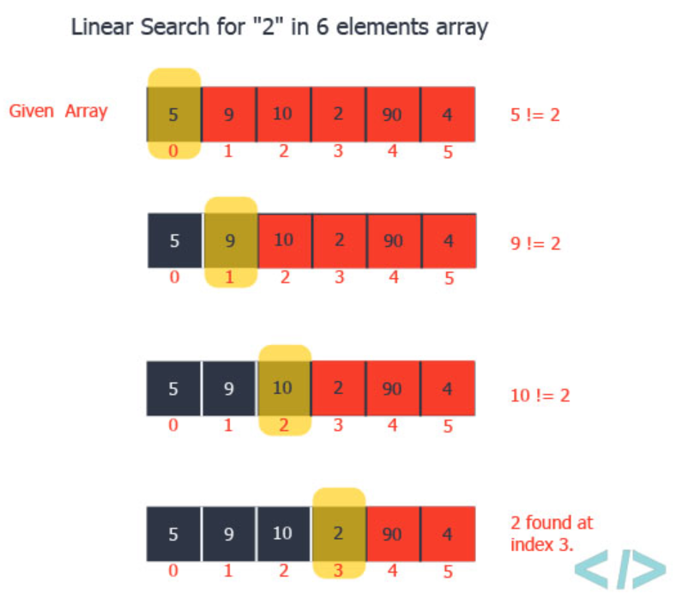
Linear Search

Slide 11
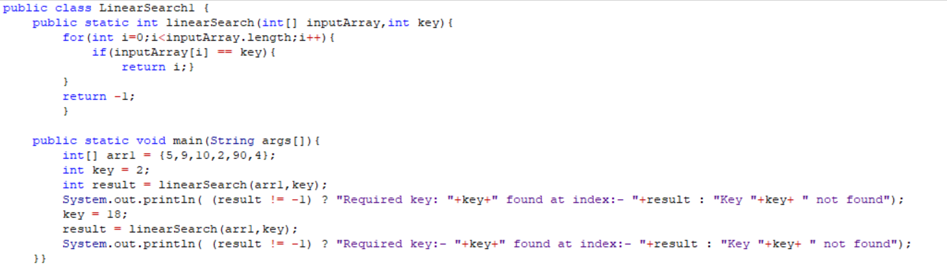
Sample Program
Linear Search

Slide 12

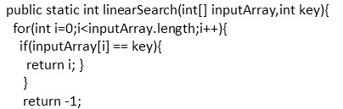

Linear Search
Sample Program

Slide 13

Linear Search
Sample Program

Slide 14
Binary Search
A binary search locates an item in a sorted array by repeatedly dividing the search interval in half.
In binary search, we first compare the key with the item in the middle position of the array.
If there’s a match, we can return immediately. If the key is less than the middle key, then the item sought must lie in the lower half of the array; if it’s greater then the item sought must lie in the upper half of the array.
Searching algorithm

Slide 15
Binary Search
So we repeat the procedure on the lower (or upper) half of the array
Finding the middle is often coded as
mid = (high + low)/2;
This overflows if high and low are close to the largest expressible integer. The following gives the same result and never overflows, if high and low are non-negative.
mid = low + (high - low)/2;

Slide 16
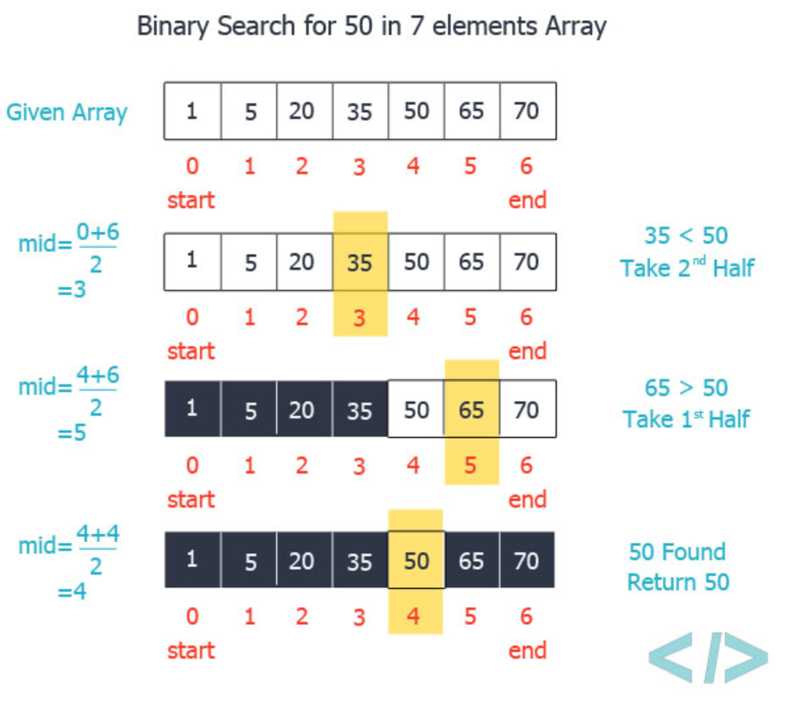
Binary Search
Begin with the mid element of the whole array as a search key.
If the value of the search key is equal to the item then return an index of the search key.
Or if the value of the search key is less than the item in the middle of the interval, narrow the interval to the lower half.
Otherwise, narrow it to the upper half.
Repeatedly check from the second point until the value is found or the interval is empty.

Slide 17
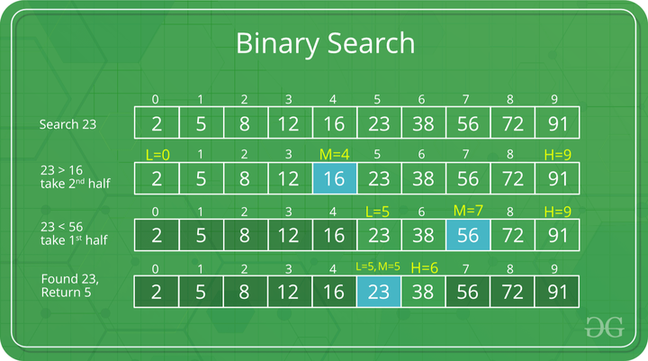
Binary Search
Begin with the mid element of the whole array as a search key.
If the value of the search key is equal to the item then return an index of the search key.
Or if the value of the search key is less than the item in the middle of the interval, narrow the interval to the lower half.
Otherwise, narrow it to the upper half.
Repeatedly check from the second point until the value is found or the interval is empty.

Slide 18
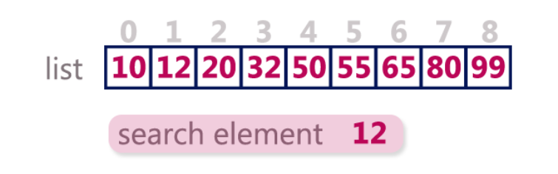
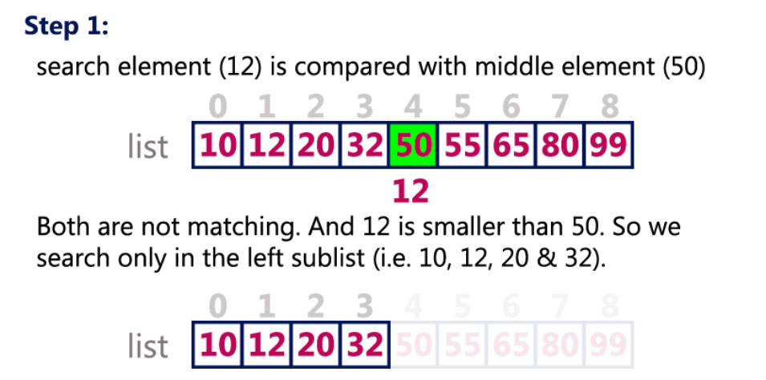
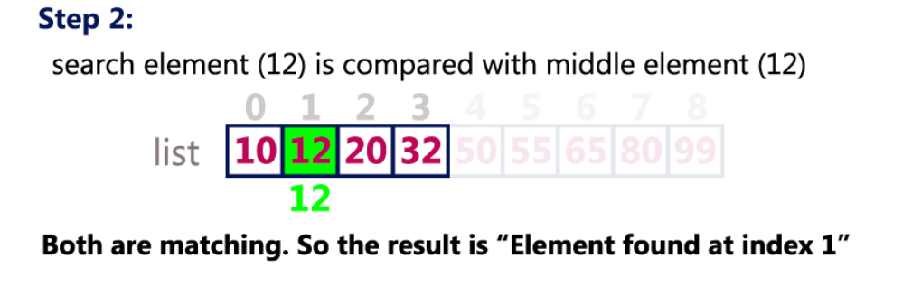
Binary Search

Slide 19
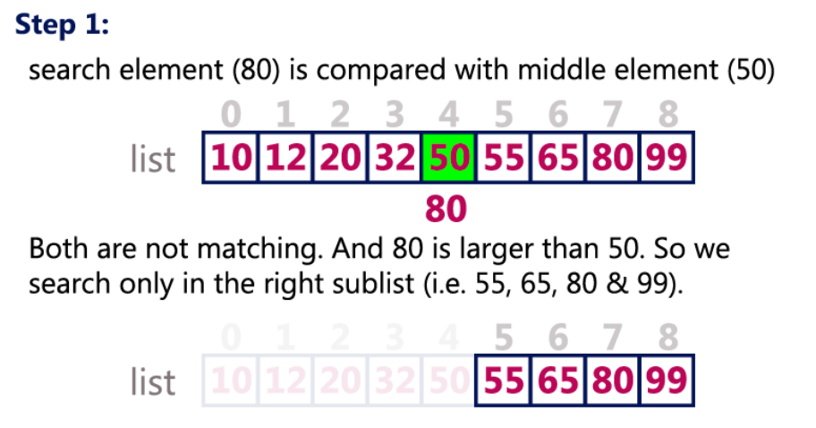
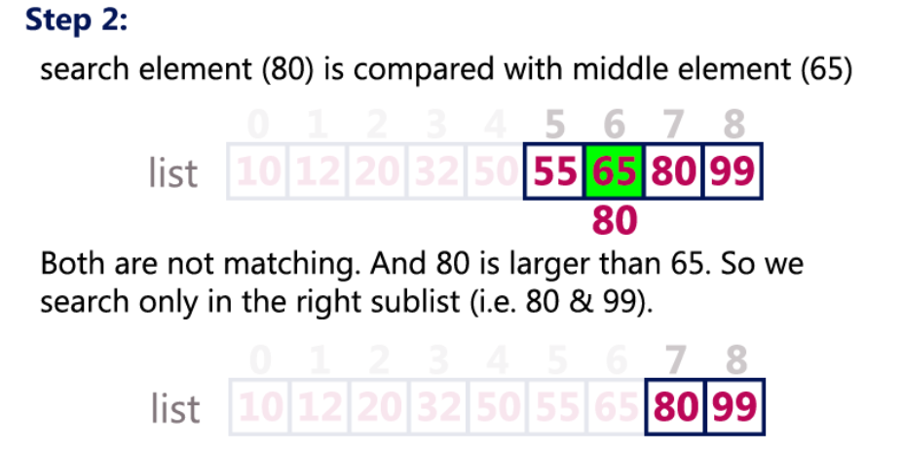
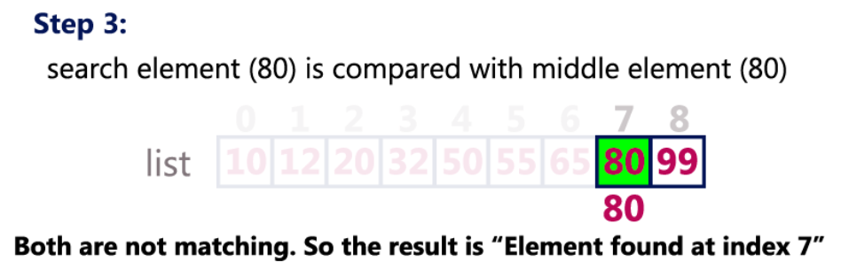
Binary Search
Search element 80

Slide 20
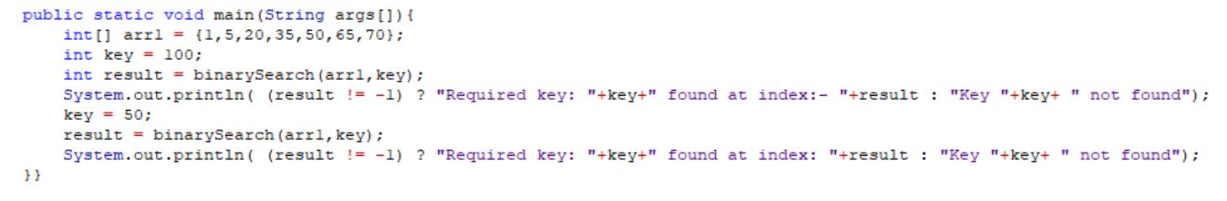
Binary Search
public class BinarySearch1 {
public static int binarySearch(int[] inputArray,int key) {
int start = 0;
int end = inputArray.length-1;
while (start <= end) {
int mid = (start + end) / 2;
if (key == inputArray[mid]) {
return mid; }
if (key < inputArray[mid]) {
end = mid - 1;}
else {
start = mid + 1; }
}
return -1; }
Searching algorithm

Slide 21

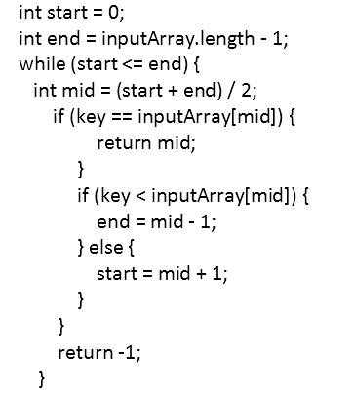
Binary Search
key = 100

Slide 22
Binary Search
key = 50

Slide 23
Thanks!
Questions?

